Slide 1


Cricket Ball Trajectory & LBW Decision System
DAA Semester Project: Algorithmic Sports Analytics
Presented by: Semester Project Team

Slide 2

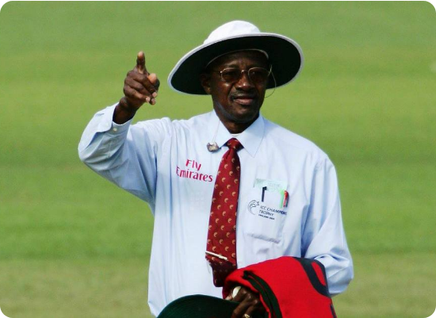
Problem Statement
The LBW Complexity
Leg Before Wicket (LBW) decisions are among the most controversial and complex judgments in cricket. They require analyzing multiple factors simultaneously:
•
Ball's initial flight path and curve
•
Exact location of the pitch point
•
Point of impact on the batsman's padding
•
Hypothetical prediction of the path after impact
Manual decisions are highly prone to human error and parallax bias.

Slide 3
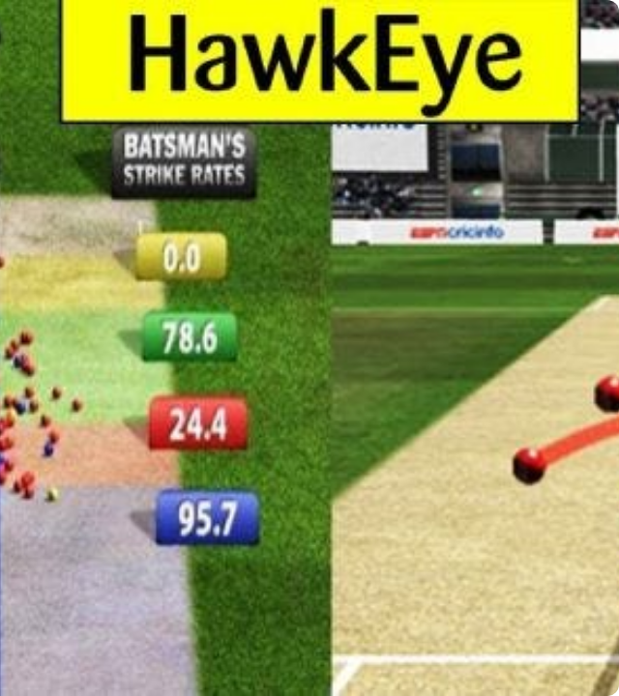
Real-World Relevance
Modern Sports Analytics
Modern cricket relies on systems like Hawk-Eye and Virtual Eye to assist umpires. This technology has revolutionized fair play and broadcast transparency.
This project demonstrates the foundational algorithms that power these multi-million dollar systems, proving how DAA principles can solve high-stakes spatial problems.

Slide 4
Project Objectives
Trajectory Computation: Using mathematical modeling to map discrete points to a continuous curve.
Impact Detection: Algorithmically detecting the exact point of obstruction at the padding plane.
Path Prediction: Extrapolating the delivery path beyond the impact point using physics-based modeling.
Collision Logic: Evaluating the "OUT" or "NOT OUT" verdict through 3D boundary checks.
Complexity Analysis: Benchmarking performance to ensure linear-time real-time processing.

Slide 5






Methodology Overview
Data Modeling
Analytics Engine
Decision Rule
Constructing the trajectory curve from tracked coordinates using OLS regression.
Applying numerical differentiation to calculate speed and spin telemetry.
Testing geometric intersection between predicted path and the wicket plane.

Slide 6


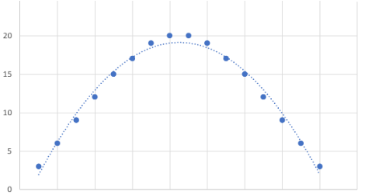

Layer 1: Data Modeling
Polynomial Regression
The system fits 3D data points to a quadratic model. This handles ball swing and height drop due to gravity.
Complexity: O(n)
Linear scanning of data points to build Normal Equations.

Slide 7

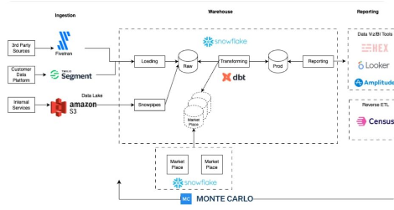
Layer 2: Future Prediction
Horner's Method
To predict the ball's future position past the impact point, we use Horner's scheme for efficient polynomial evaluation.
•
Extrapolates from impact (x=17.5m)
•
Predicts height (y) at stumps
•
Predicts lateral deviation (z)
Complexity: O(k)
Evaluation at k discrete prediction intervals.

Slide 8

Layer 3: Decision Logic
Geometric Rule Engine
The final "OUT" verdict is a computational geometry problem: intersection check between a point and a 3D bounding box.
•
Stump Plane: x = 20.0m
•
Height Check: 0.0 ≤ y ≤ 0.72
•
Width Check: -0.115 ≤ z ≤ 0.115
Complexity: O(1)
Constant time conditional boundary evaluation.

Slide 9

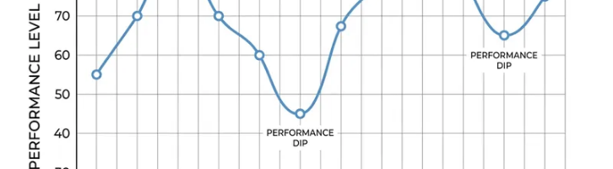
Overall Time Complexity
System Efficiency Analysis
The total complexity is O(n + k), which asymptotically simplifies to O(n).
O(n)
This allows the engine to process incoming video frames and tracking data in real-time without computational bottleneck, providing immediate telemetry to the dashboard.
Linear Performance

Slide 10



Tools & Technologies
Python 3.12
NumPy & Math
Streamlit & Plotly
Core algorithmic implementation and modular structure.
High-performance linear algebra and OLS solvers.
Web dashboard and animated 3D visualization engine.

Slide 11


Expected Outcomes
Deliverable | Algorithmic Goal | Visual Feature
3D Path Engine | 98% Accuracy Curve Fitting | Neon Trajectory Trails
Telemetry Panel | Instant velocity (O(n)) | Real-time km/h Cards
Animated Simulation | Linear Interpolation | Interactive Playback
Decision Validator | Intersection logic (O(1)) | Color-Coded Verdicts
Deliverable Algorithmic Goal Visual Feature

Slide 12

Questions?
Thank you for your attention!
"The perfect decision is just an algorithm away."

Slide 13






Image Sources
https://png.pngtree.com/png-clipart/20230131/ourmid/pngtree-stadium-white-lighting-effects-png-image_6579537.png
Source: pngtree.com
https://prajithnakarnimana.wordpress.com/wp-content/uploads/2020/05/steve-bucknor.jpg?w=1024
Source: prajithnakarnimana.wordpress.com
https://miro.medium.com/0*UsMrQecD7dpJcYhe.jpg
Source: medium.com
https://scales.arabpsychology.com/wp-content/uploads/2023/11/quadratictrend5.png
Source: scales.arabpsychology.com
https://www.montecarlodata.com/wp-content/uploads/2023/07/Data-pipeline-architecture-swimply-1024x492.jpg
Source: www.montecarlodata.com
https://media.istockphoto.com/id/1504077057/video/slow-motion-cricket-ball-striking-wickets.jpg?s=640x640&k=20&c=R5W1XIqXm5Md6rmWqMP-ElAtJz4AWfEFebsTD0q8Euw=
Source: www.istockphoto.com

Slide 14



Image Sources
https://media.easy-peasy.ai/b6bf4e7c-c927-464f-82e5-95aaefa9ed93/b9754c20-5408-4b49-a411-2f84e6dd3c76_medium.webp
Source: easy-peasy.ai
https://assets.visme.co/templates/whiteboards/thumbnails/i_Sports-Analytics-Dashboard-Whiteboard_full.jpg
Source: www.visme.co
https://gstatic1.promeai.pro/gallery/publish/2024/10/16/a490f99d14ae4f749fdc60ce71fc34a4.jpg
Source: www.promeai.pro

